Slide 1

HOME AUTOMATION USING AURDINO UNO

Slide 2
OBJECTIVE
The main aim of this project is to operate and control the home appliances like lights , fans etc. by using mobile phone
We use aurdino UNO for controlling

Slide 3
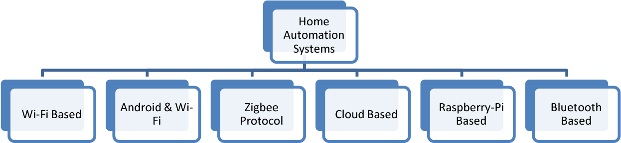
TYPES OF HOME AUTOMATION SYSTEMS

Slide 4
COMPONENTS USED
Aurdino UNO
Bluetooth hc-05
Bread board
Relay module
Connecting wires
Power supply
bulb , fan….etc

Slide 5
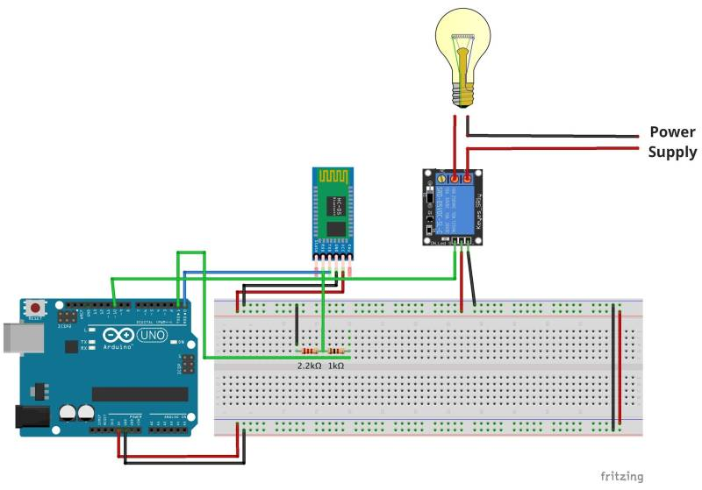

Slide 6
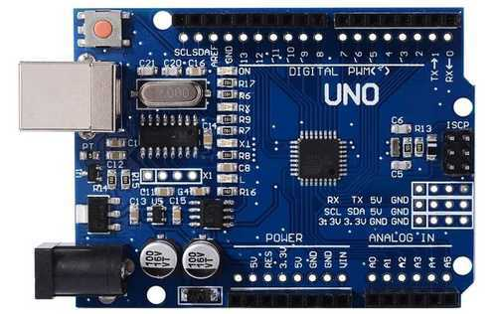
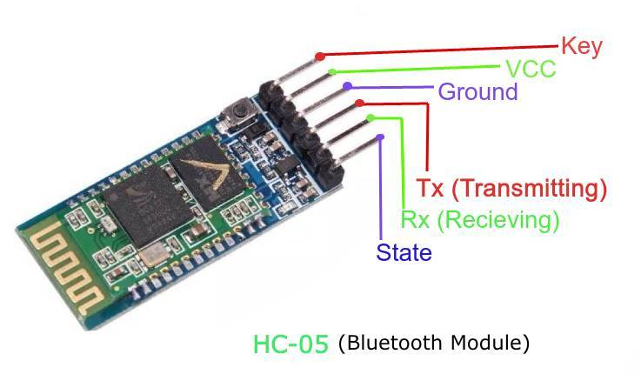
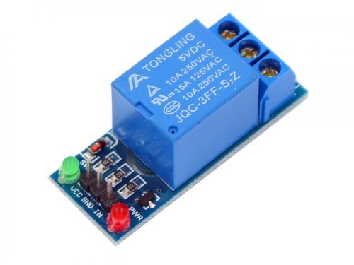
Aurdino UNO
Relay module

Slide 7
ARDUINO UNO:
Arduino uno is a low-cost, flexible, and easy-to-use programmable open-source microcontroller board that can be integrated into a variety of electronic projects. This board can be interfaced with other Arduino boards, Arduino shields, Raspberry Pi boards and can control relays, LEDs, servos, and motors as an output.
Arduino UNO features AVR microcontroller Atmega328, 6 analogue input pins, and 14 digital I/O pins out of which 6 are used as PWM output

Slide 8
Features of the Arduino UNO:
Microcontroller: ATmega328
Operating Voltage: 5V
Input Voltage (recommended): 7-12V
Input Voltage (limits): 6-20V
Digital I/O Pins: 14 (of which 6 provide PWM output)
Analog Input Pins: 6
DC Current per I/O Pin: 40 mA
DC Current for 3.3V Pin: 50 mA
Flash Memory: 32 KB of which 0.5 KB used by bootloader
SRAM: 2 KB (ATmega328)
EEPROM: 1 KB (ATmega328)
Clock Speed: 16 MHz

Slide 9
Bluetooth Module HC-05
It is used for many applications like wireless headset, game controllers, wireless mouse, wireless keyboard and many more consumer applications.
It has range up to <100m which depends upon transmitter and receiver, atmosphere, geographic & urban conditions.
It uses serial communication to communicate with devices. It communicates with microcontroller using serial port (USART).

Slide 10
Relay
Relays are switches that open and close circuits electromechanically or electronically.
Relays control one electrical circuit by opening and closing contacts in another circuit.
As relay diagrams show, when a relay contact is normally open (NO), there is an open contact when the relay is not energized.
When a relay contact is Normally Closed (NC), there is a closed contact when the relay is not energized.
In either case, applying electrical current to the contacts will change their state.

Slide 11
ADVANTAGES
It is a robust and easy to use system
It will save your energy and money
Provide security
Convenience and comfort
Can be used by physically challenged and disabled persons
Complexity is as single mobile is used for multiple devices
Smart home tecnology

Slide 12
THANK YOU

